Slide 1
Template inheritance
Dr. Navneet Kaur

Slide 2
Template Inheritance
Template Inheritance is like making a blueprint for your web pages.
You create a main template with common parts like headers and footers, and then you make other templates that use this main template as a base.
This way, you only have to change the common parts in one place, making it easier to manage your website's design.

Slide 3
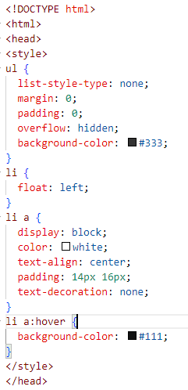
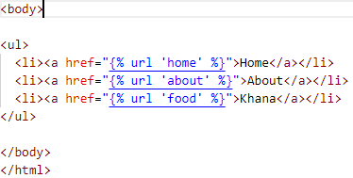
Template Inheritance
header.html

Slide 4
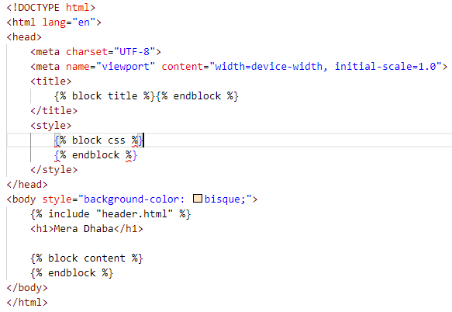
Template Inheritance
base.html

Slide 5
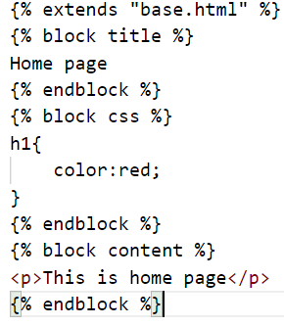
Template Inheritance
home.html

Slide 6
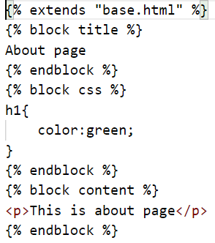
Template Inheritance
about.html

Slide 7
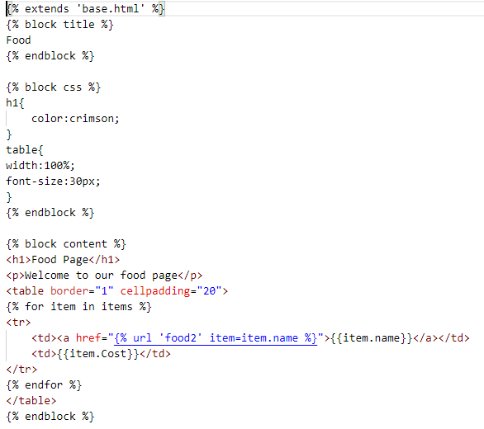
Template Inheritance
food.html

Slide 8
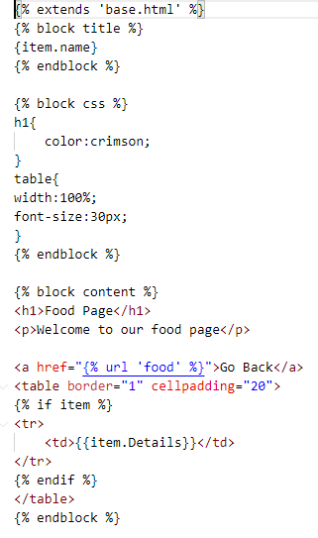
Template Inheritance
food2.html

Slide 9
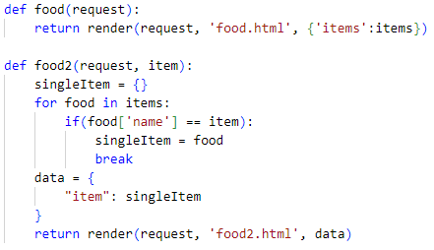
Template Inheritance
views.py

Slide 10

Template Inheritance
urls.py

